Slide 1
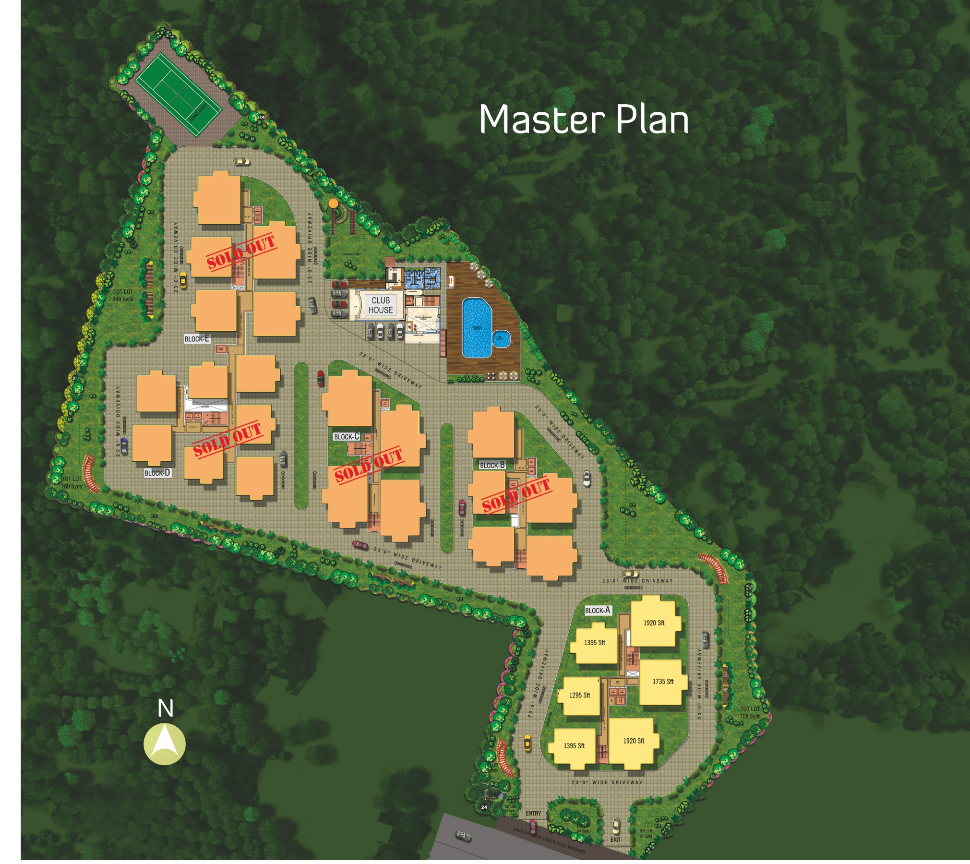
LAN Design for Golf View Apartments
Subhajit Sahu
2018801013
Block E
Club House
Personal Areas:
Block A: 6 flats x 15 floors = 90
Block B: 5 flats x 14 floors = 70
Block C: 4 flats x 14 floors = 56
Block D: 7 flats x 14 floors = 98
Block E: 5 flats x 14 floors = 70
Total flats = 384
Common Areas:
Club House: 4 rooms x 2 floors = 8
Basement (private parking)
Garden, Playgrounds
Footpath, Guest parking
Entrance, Exit Gate
Block D
Block C
Block B
Exit
Block A
Entrance

Slide 2
Network Requirements
Personal Areas:
200Mbps private connection per flat (384).
A flat may choose a lower or higher bandwidth.
All flats in a block choose a common ISP.
Each floor needs 3 security cameras (2 stairs, 1 lift).
Up to 6 security cameras per block in ground floor (entrances).
Flats: 1 WiFi router x 384 flats = 384
Common Areas:
200Mbps Public WiFi for each room in club house.
Basement should support up to 15 security cameras.
200Mbps Public WiFi in garden, playgrounds, footpath (10+).
Up to 15 security cameras along the footpath (max).
2 HD security cameras at entrance, exit.
Centralized security monitoring at A-106 for all blocks.
Club House: 4 WiFi AP x 2 floors = 8
Garden, Playgrounds, Footpath: 10 WiFi AP (long range)

Slide 3
Network Plan: Personal Areas
The network for Golf View Apartments requires a personal (private) internet connection per-user as well as a public internet connection, that is paid through their society expenses.
For the personal network, each flat is provided with a WiFi router, which creates a private LAN within the flat.
All devices in each flat receive a private IP address or the form 192.168.1.*, which the router translates to a public IP address when it forwards packets to the internet.
The router itself recieves its public IP address from the DHCP server installed at ISP's central office. In order to make this work, all routers (from all flats) are connected into a single network, which it then linked with the ISP through single-mode fiber cable on the switch. A managed switch is used to allow rate-limiting per user if necessary.
Routers of each block are connected up into a single network, and they are then connected to the ISP separately. This ensures it is possible to switch ISP for each block separately is so desired by the owners.
8-port gigabit unmanaged switches connect all routers on a floor (4-7). Each such switch is then connected to the central managed switch per block. The central switch is a 10 gigabit switch with 4 SFP ports for optical fibre termination from ISP.
Assuming an average of 6 flats per floor with 200Mbps connection a 1 Gb switch should be enough as users are not all using full-bandwidth all the time.
Similarly a 10 Gb central switch is expected to be sufficient for an average of 14 floor (per block).
Per floor a network cabinet, w/ patch panel is used, and network rack w/ patch panel in central room (106).

Slide 4
Network Plan: Common Areas
The common areas for Golf View Apartments require a public internet connection, that is paid through their society expenses. This is designed as a separate network, which connects all IP security cameras and wireless access points on a local network. This local network is then connected through a router to an ISP.
All the network devices (cameras, APs) are intially connected to other nearest ones with an 8-port gigabit unmanaged switch (this includes the ones withing the club house), and later connected to the nearest 24-port 10 gigabit managed central switch that is installed one per block.
The central switch is to be kept in flat 106 of each block. This flat is reserved by the management. This central switch is not connected to the Personal Net central switch also present at the same site.
The per-block central switches are then connected with Cat6 cable (all ethernet cables used are Cat6) to the central router that is placed in Block A.
This central router makes the common area devices into one common private network, assigning private IP addresses to each device withough its DHCP.
The router in turn recieves its public IP from ISP's DHCP and its uses this to translate any packets sent from cameras & APs to public IP for the internet, vice versa.
The central router is 10 gigabit with 2 SFP ports for optical fibre termination from ISP.
The society doesn’t expect heavy internet usage from common areas and hence 10 GbE per-block switches & 10 GbE central router is considered sufficient.
Uses same rack space as the Personal Net devices.

Slide 5
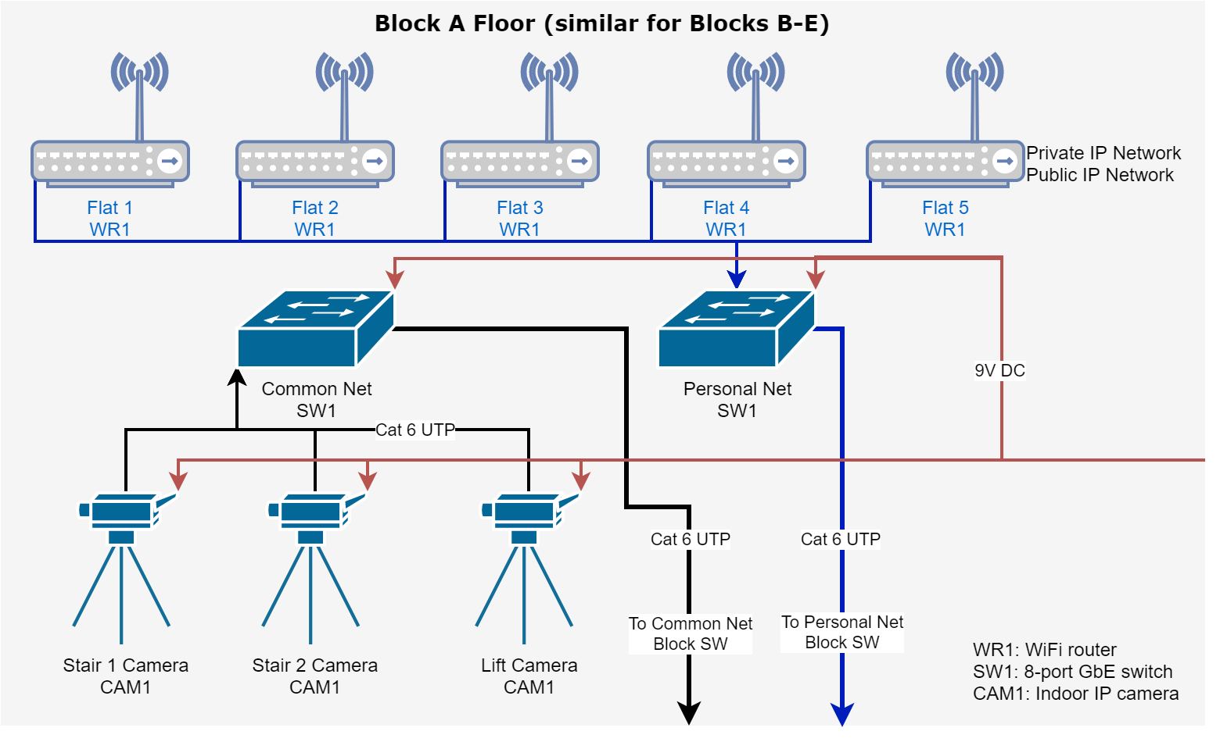
Network
Design

Slide 6
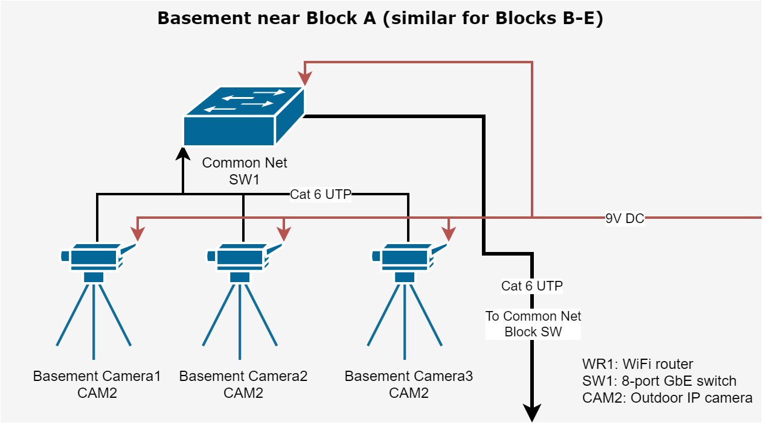
Network
Design

Slide 7
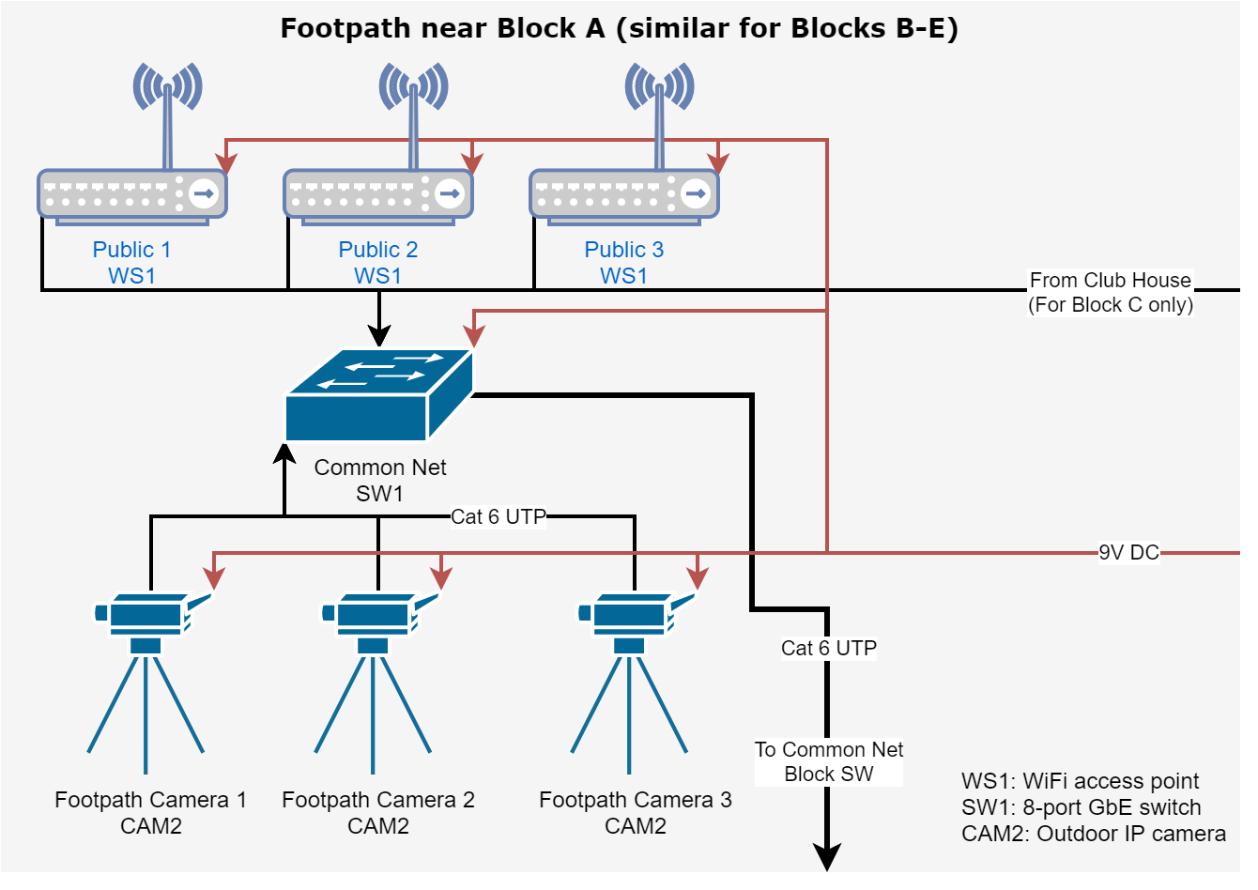
Network
Design

Slide 8
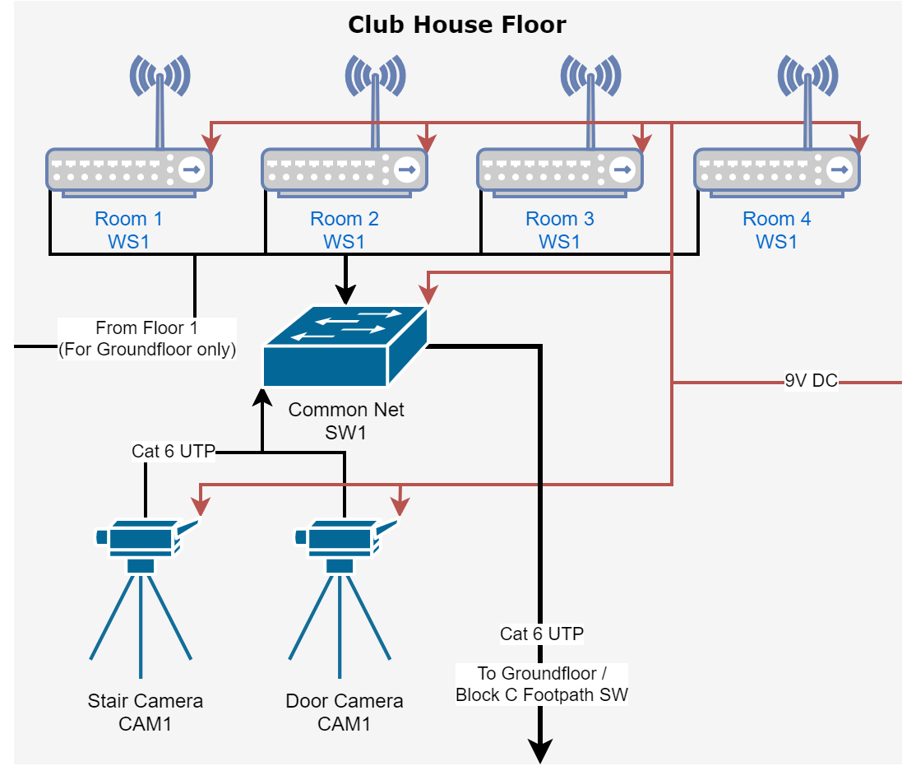
Network
Design

Slide 9
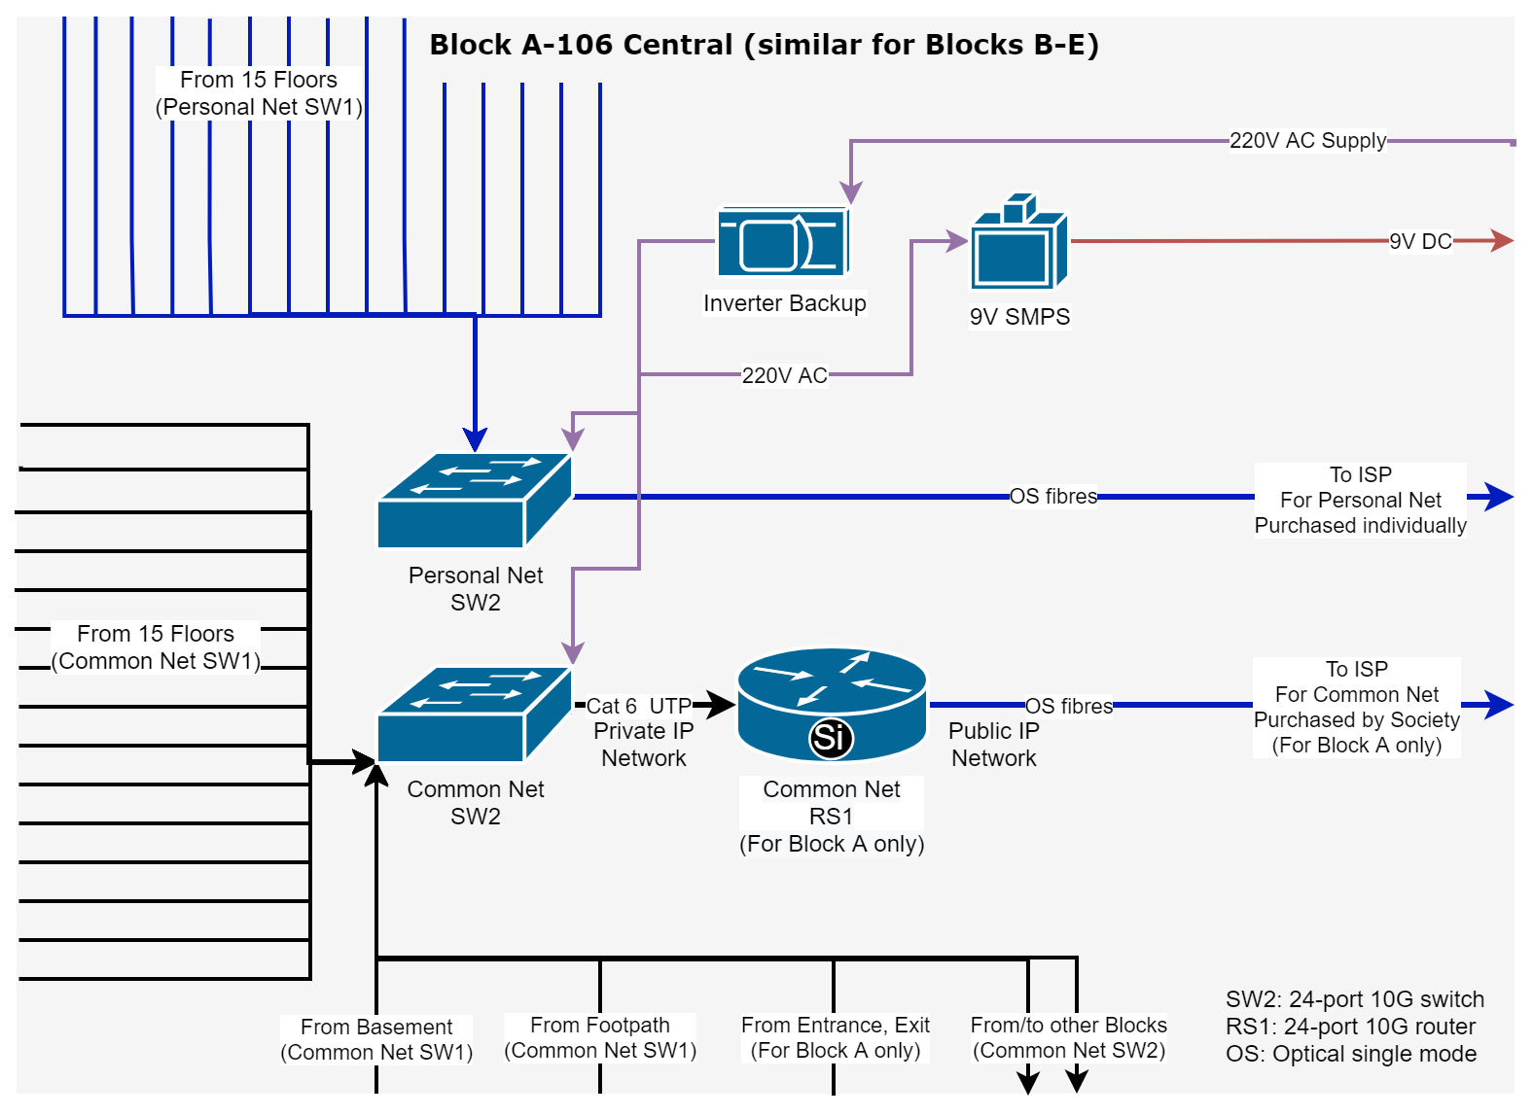
Network
Design

Slide 10
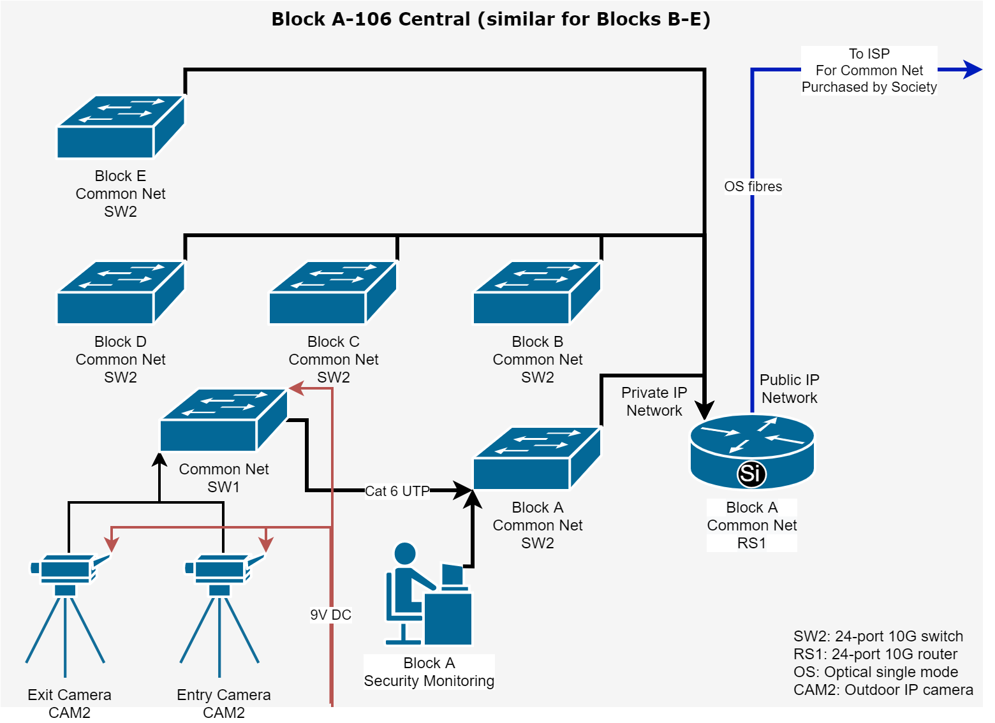
Network
Design

Slide 11
Network Implementation
MikroTik CRS326-24G-2S+RM router: ₹18,000
Ubiquiti UF-SM-10G transciever: ₹4,000
TP-Link Jetstream T1600G-28TS switch: ₹1,90,000
TP-Link 10GBase-LR SFP+ LC Transceiver: ₹20,000
TP-Link TL-SG108E switch: ₹4,16,000
TP-Link TL-WA901N WiFi AP: ₹37,500
TP-Link TL-WR845N WiFi router: ₹6,54,500
2U Wall mount Cabinet Box: ₹1,10,500
12U Wall mount Network Rack: ₹48,000
Cat6 RJ45 Connector Plugs w/ Hood: ₹18,000
Cat6 Ethernet Cable (Roll): ₹1,50,000
RJ45 Cat6 Cable Jointer: ₹3,000
1.5m Cat6 Patch Cable: ₹1,35,000
M6 Cage Nuts, Washers & screws: ₹27,000
Mass Rack 10" Tray: ₹36,000
D-Link 24-port Cat6 Patch Panel: ₹2,70,000
RJ45/11 Crimper, Cutter & Stripper Tool: ₹3,000
River Fox Punch Down Tool Cat 5e/6: ₹1,500
Moelissa MS-LT02 RJ45/11 Cable tester: ₹1,500
Total Cost: ₹21,43,500

Slide 12
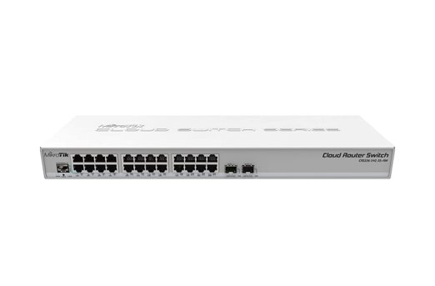
MikroTik CRS326-24G-2S+RM Cloud Router Switch
RS1
This is the router for devices (cameras, WiFi access points) common network. It does the job of a DHCP server, assigning private IP addresses to each common net device and translating any packets forwarded to the internet to public address (NAT/PAT).
Single mode optical fibre connection from ISP is terminated here (from ISP's central office). This is a separate connection taken by the Golf View Society and a common internet connection for internet access provided in Club House, Gardens, Playgrounds & Footpath.
24 x 1 Gb ethernet port
2 x 10 Gb SFP+ cages
Dual boot RouterOS / SwOS
1 as the central router.
Quantity: 1
Cost: ₹18000 x 1 = ₹18,000

Slide 13
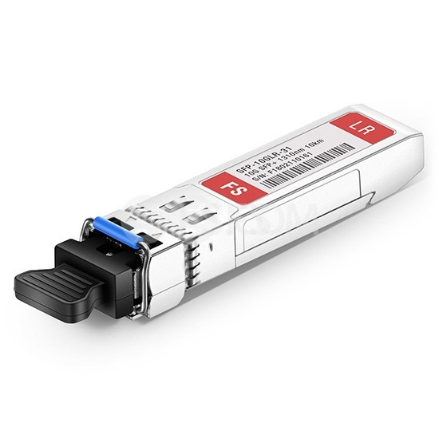
Ubiquiti UF-SM-10G 1310nm 10km SFP+ Transceiver
This Small Form-factor Pluggable (SFP) optical transceiver is to be inserted into the SFP+ cage of RS1, so that a 10Gpbs 1270/1330nm fiber line can be terminated at the router. The optical fiber must be a single-mode fiber upto 10km length. It accepts dual LC connector
This is the router for devices (cameras, WiFi access points) common network. It does the job of a DHCP server, assigning private IP addresses to each common net device and translating any packets forwarded to the internet to public address (NAT/PAT).
Single mode optical fibre connection from ISP is terminated here (from ISP's central office). This is a separate connection taken by the Golf View Society and a common internet connection for internet access provided in Club House, Gardens, Playgrounds & Footpath.
2 per block as central switch.
Quantity: 2 x 5 blocks = 10
Cost: ₹2000 x 2 = ₹4,000

Slide 14
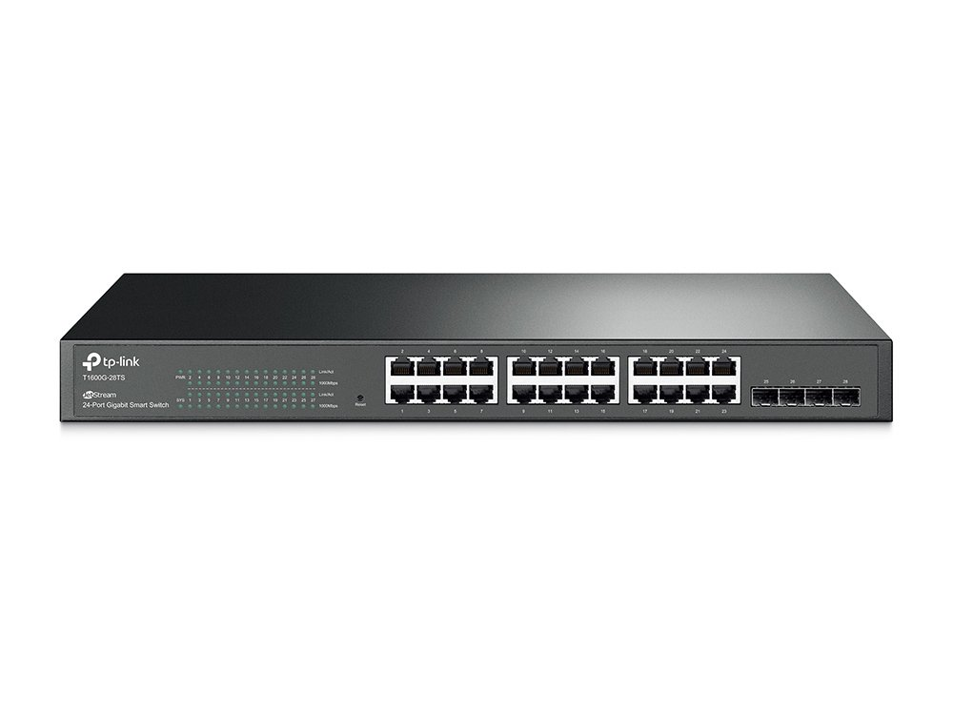
TP-Link Jetstream T1600G-28TS 24port Managed Switch
SW2
This is the central switch that is for both personal & common net.
In the personal net, each floor's router connect to this central switch. Single mode optical fibre connection from ISP is terminated here (from ISP's central office). This conection is kept different for each block. The ISP's DHCP assigns public IP to all home routers in each flat.
In the common net, switches from club, basement, footpath conect here. This is installed per block, so the access switches always connect to the nearest central switch. The central switches are the connect together from each block to the central router over Cat6 cable. As a whole they form a LAN behind the router.
24 x 1 Gb ethernet port
4 x SFP slots
2 per block as central switch.
Quantity: 2 x 5 blocks = 10
Cost: ₹19000 x 10 = ₹1,90,000

Slide 15
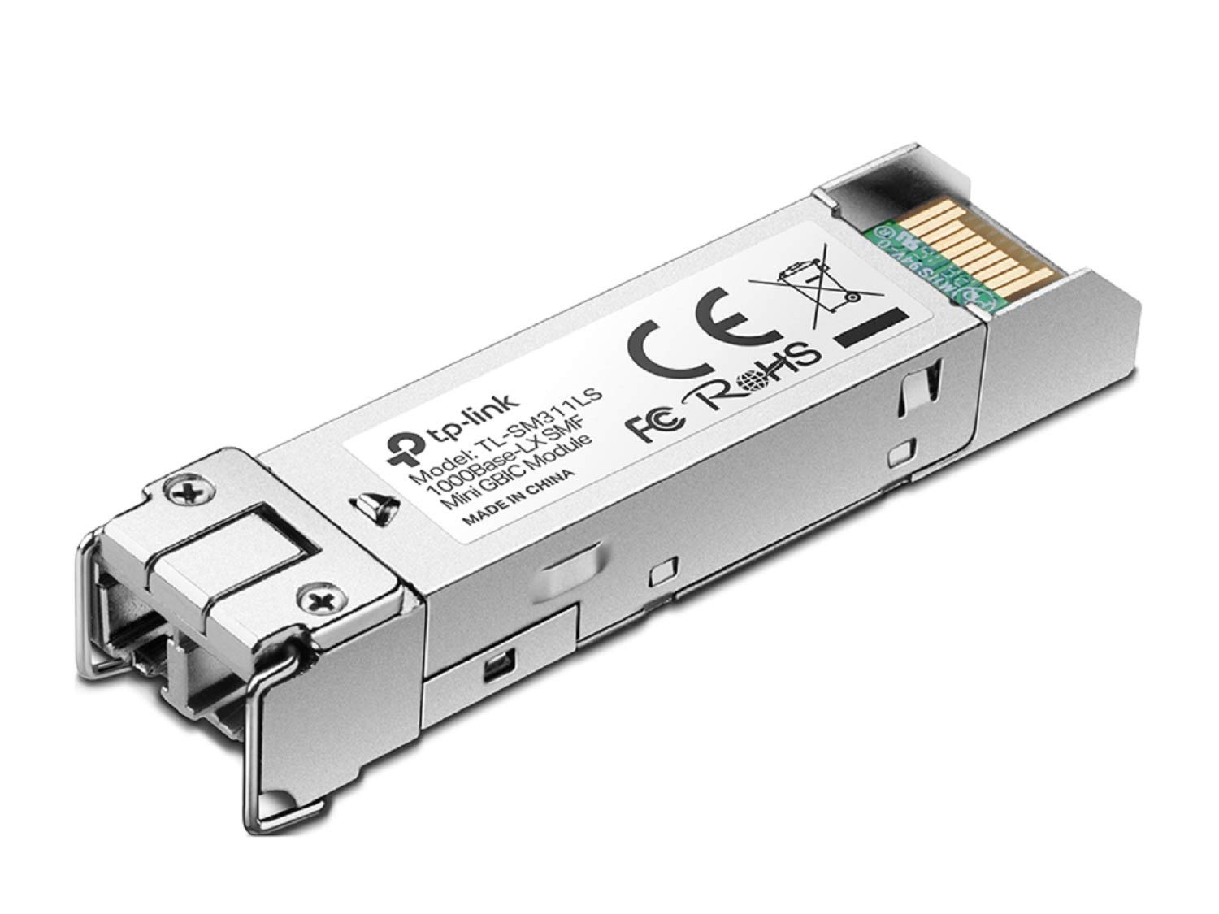
TP-Link 10GBase-LR SFP+ LC Transceiver
This is used with private net central switches to conect to ISP. The connection is individually made for each block.
Single mode optical fibre connection from ISP is terminated through (from ISP's central office) this transciever.
Wave Length 1310 nm
Fiber Type 9/125 μm Single-Mode
Max. Cable Length 10km
Data Rate 1.25 Gbps
Data Rate 10Gbps
Port Type LC/UPC
2 per central switch of personal net.
Quantity: 2 x 5 blocks = 10
Cost: ₹2000 x 10 = ₹20,000

Slide 16
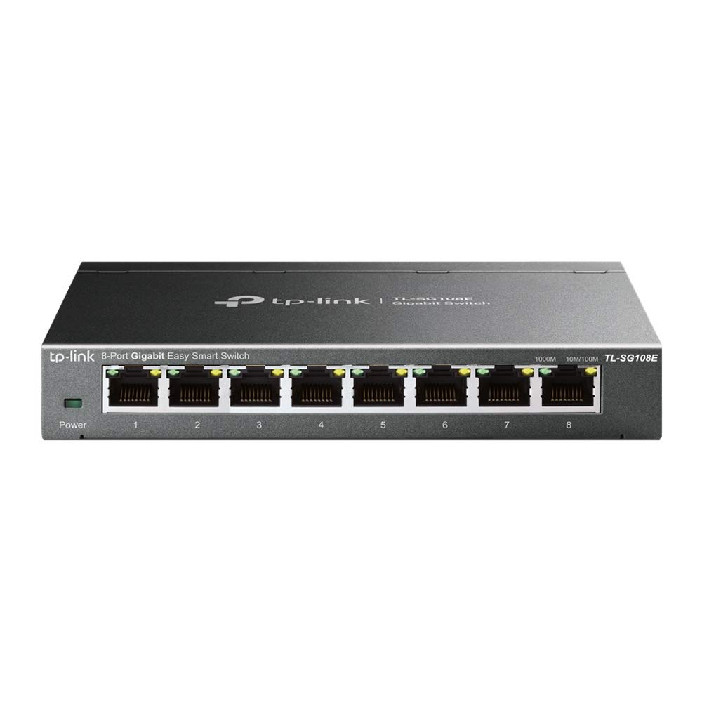
TP-Link TL-SG108E 8-port GbE Unmanaged Switch
SW1
This is an unmanaged switch that is used to make first level connections in both the personal and the common network. It then connects to the nearest central switch that is installed per block.
2 per floor (inc. club), 5 for basement, 5 for footpath, 1 for entry.
Quantity: 2 x 14 floors x 4 blocks + 2 x 15 floors + 2 club + 5 basement + 5 footpath + 1 entry + 2 spares = 160
Cost: ₹2600 x 160 = ₹4,16,000

Slide 17
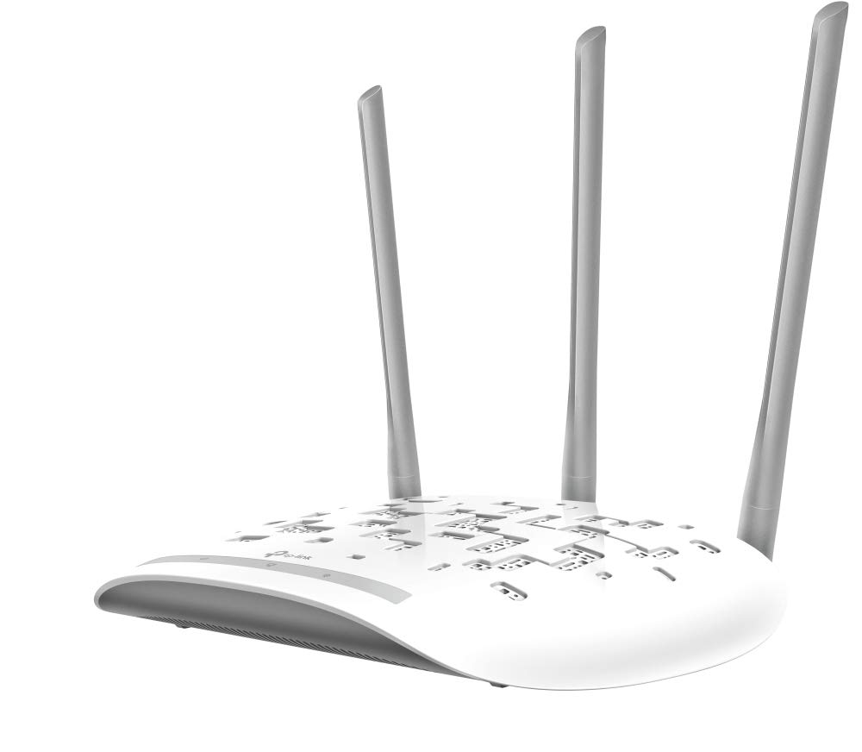
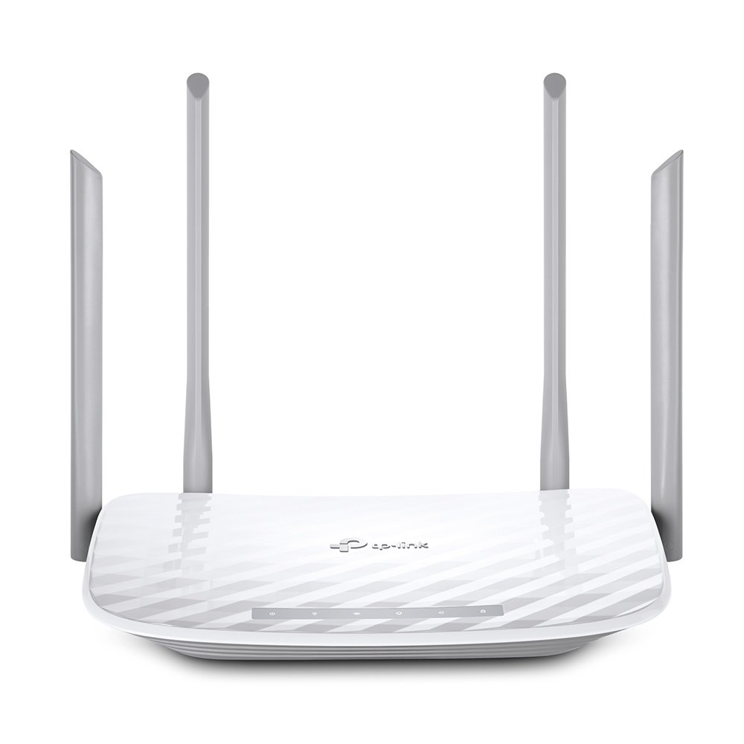
TP-Link TL-WA901N Wireless Access Point
TP-Link Archer A5 AC 1200 WiFi Dual Band Wireless Router
This a wireless access point without a router. It has the ability to extend WiFi. Used to provide internet connection in common areas.
1 in each room of club house + 15 across footpath
Quantity: 4 rooms x 2 floors (club) + 15 footpath + 2 spares = 25
Cost: ₹1500 x 25 = ₹37,500
This wireless router is provided to each flat. It is a dual band router to support more mobile devices.
1 for each flat
Quantity: 1 x 384 flats + 1 spare = 385
Cost: ₹1700 x 385 = ₹6,54,500

Slide 18
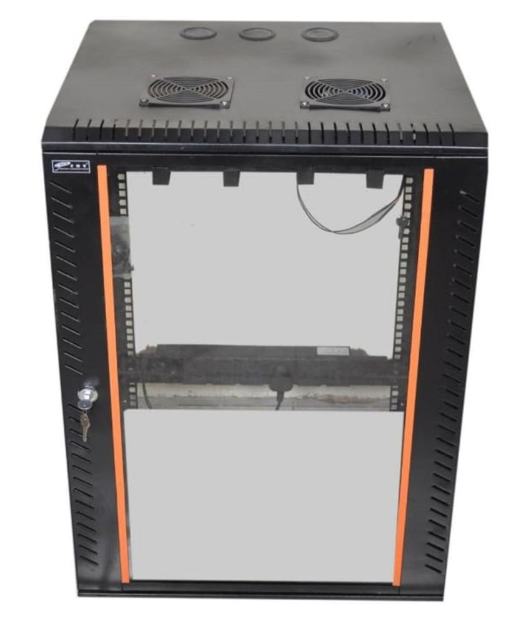
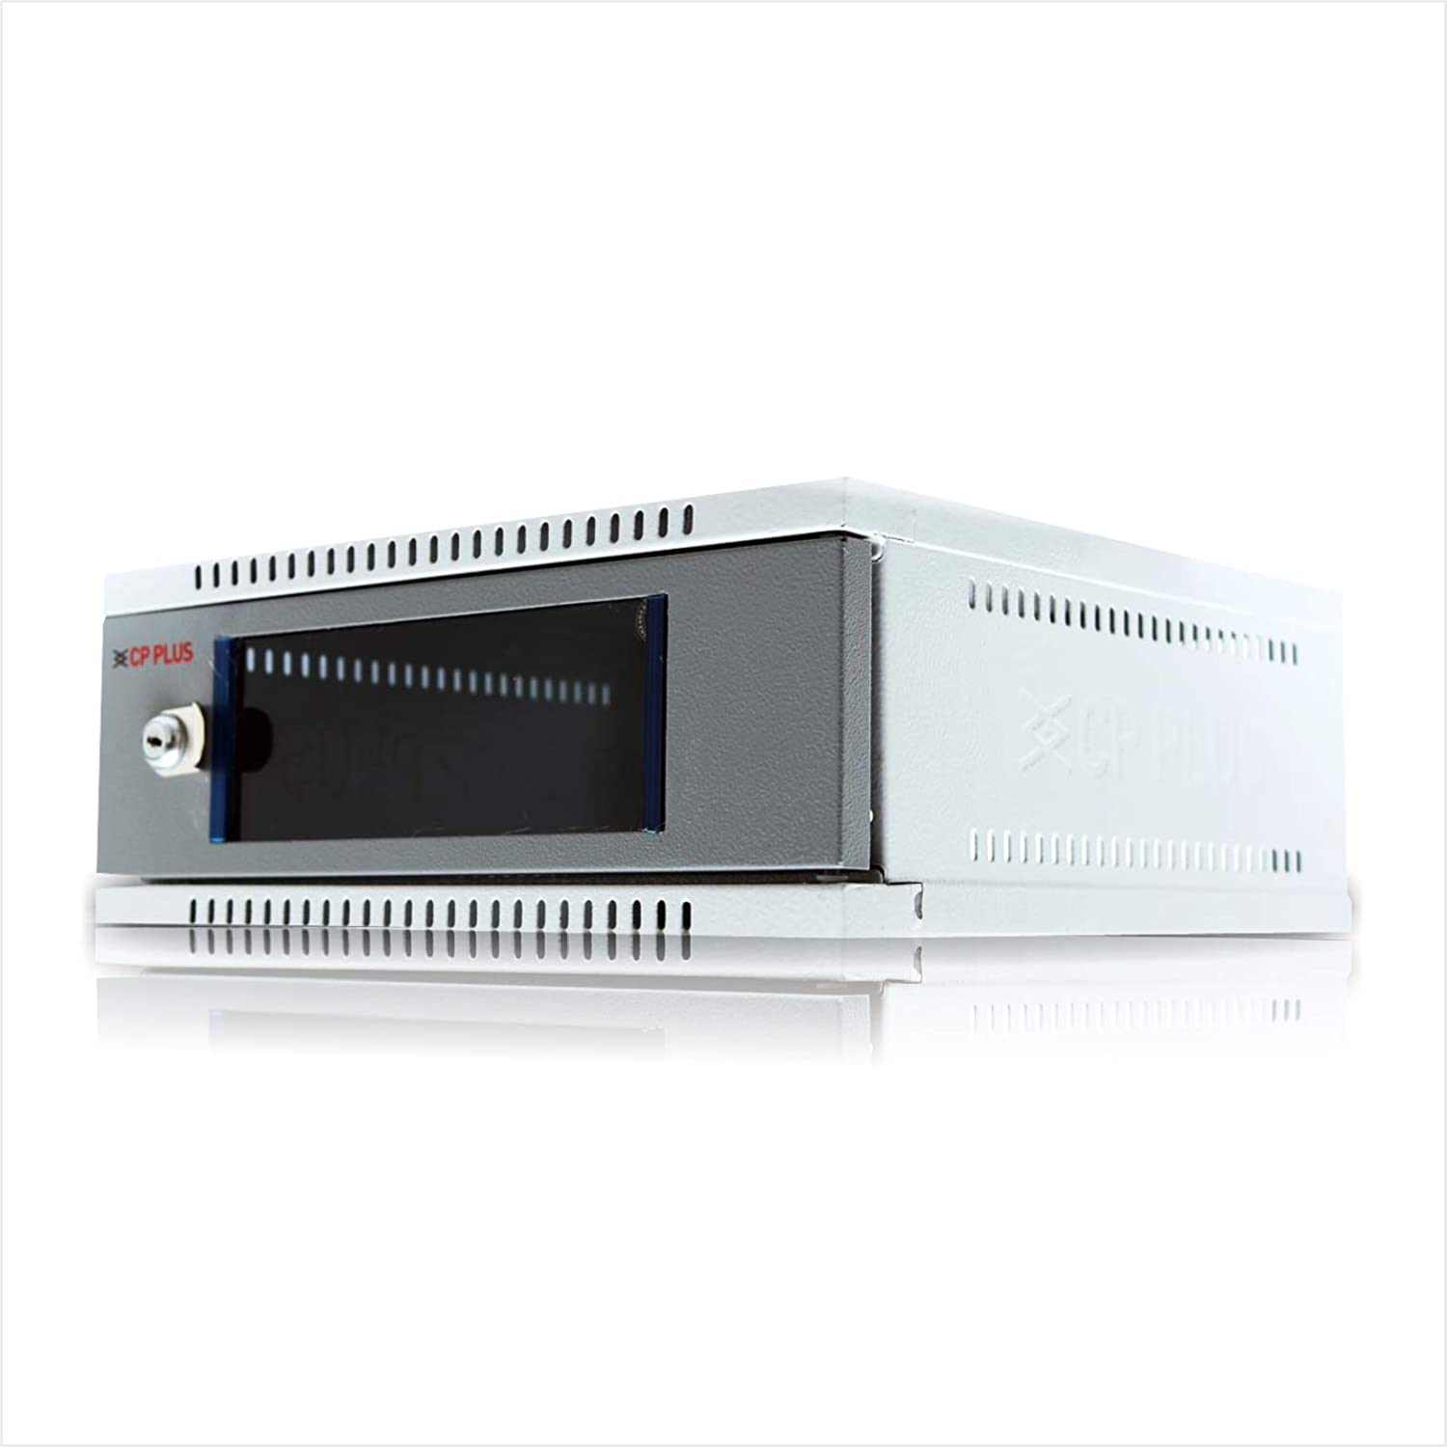
2U Wall mount Cabinet Box
12U Wall mount Network Rack
Holds the network devices onto the wall, for stable setup.
1 per floor + 2 for club + 1 for basement/block + 1 external/block + 1 entry/exit
Quantity: 1 x 14 floors x 4 blocks + 1 x 15 floors + 2 club + (1 + 1) x 5 blocks + 1 entry + 1 spare = 85
Cost: ₹1300 x 85 = ₹1,10,500
Holds the network devices onto the wall, for stable setup.
1 per block (for switches) + 1 for central router
Quantity: 1 x 5 blocks + 1 = 6
Cost: ₹8000 x 6 = ₹48,000

Slide 19
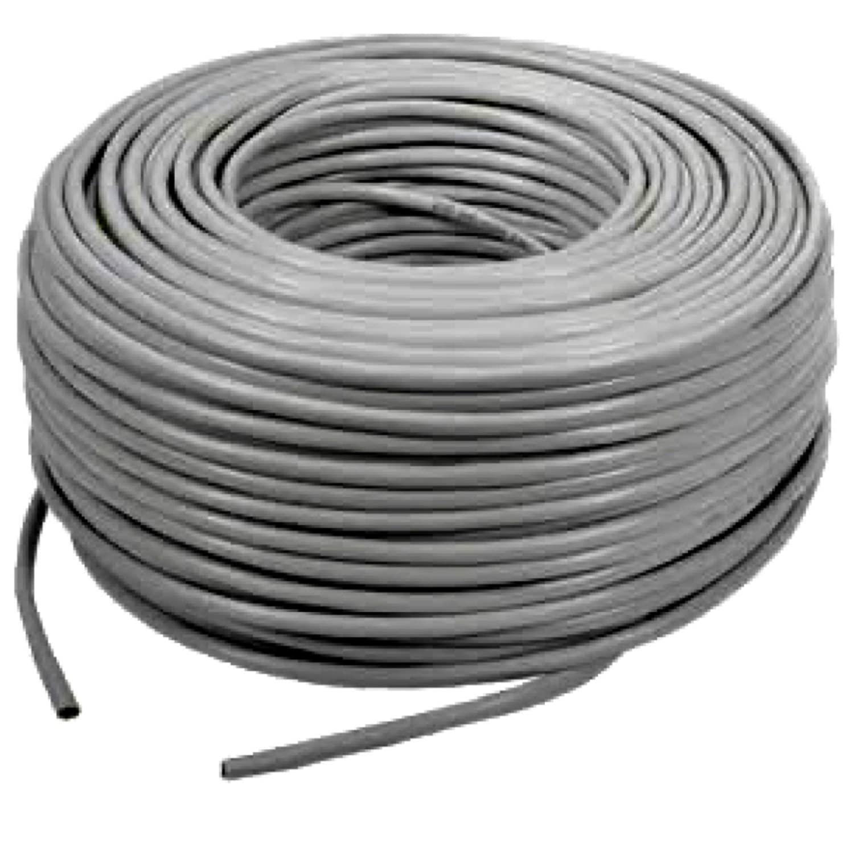
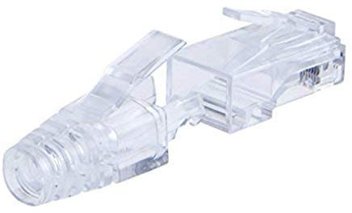
Cat6 RJ45 Connector Plugs w/ Hood
Cat6 Ethernet Cable (Roll)
This is the connector for Cat6 cable with staggered pins, which helps isolate signals at the port. It also minimizes distance from cable to reduce cross-talk.
2 per flat, 4 + 6 per floor (camera), 2 for external long connections, 2 for external short connections, 2 for block-block connections.
Quantity: 2 x 384 flats + 10 x 14 floors x 4 blocks + 10 x 15 floors + 2 x (15 basement + 15 footpath cam + 15 wireless AP) + 2 x 2 entry/exit + 2 x (3 + 3 + 3) + 2 + 2 x 4 blocks + 400 spare = 2000
Cost: ₹9 x 2000 = ₹18,000
Cat 6 cable supports 10Gbps utp 55m & 1Gbps upto 100m. Unlike Cat5e cable its wire pairs are twisted tighter, and it has a central plastic pair separator to maintain inter-pair distance as mentioned in the Cat6 specification. It is used for all cabling for uniformity sake.
Avg. 10m per flat, avg. 40m + 30m (camera) per floor, 20m for external long connections, 10m for external short connections (including club house), 60m for block-block connections.
Quantity: 10 x 384 flats + 70 x 2 x 14 floors x 4 blocks + 70 x 2 x 15 floors + 10 x (15 basement + 15 footpath cam + 15 wireless AP) + 10 x 2 entry/exit + 20 x (3 + 3 + 3) + 20 + 60 x 4 blocks + 310 spare = 15000
Cost: ₹10 x 15000 = ₹1,50,000

Slide 20
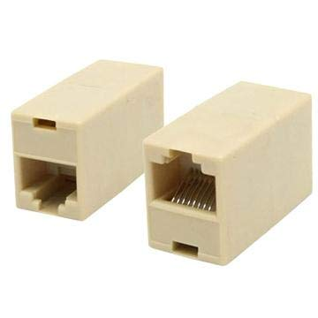
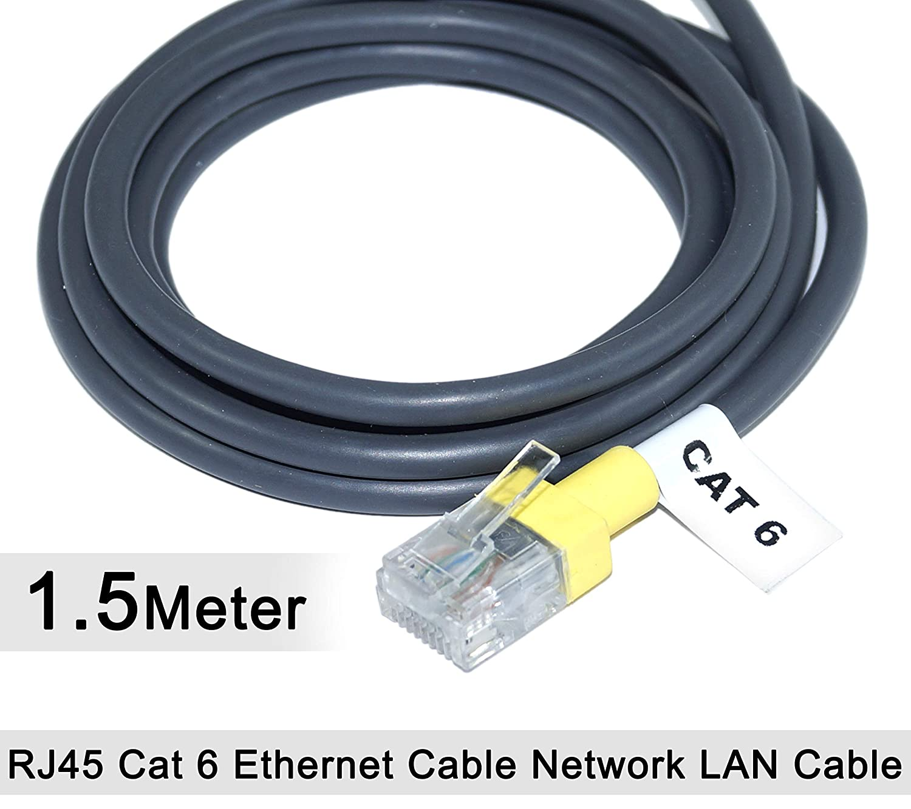
RJ45 Cat6 Cable Jointer (Couple Plug)
1.5m Cat6 Patch Cable
It is used to connect together 2 ethernet cables to form a longer cable. It also helps for maintaining some modularity.
2 per IP security camera & wireless AP.
Quantity: 2 x (15 basement + 15 footpath cam + 15 wireless AP) + 2 x 2 entry/exit cam + 6 spares = 100
Cost: ₹30 x 100 = ₹3,000
It makes it easy to make a connection between a port in a patch panel to a port on a network device. It is usually made of stranded copper wire for repeated use.
16 needed per floor (inc. club house). 48 needed per block, central room & a few spares.
Quantity: 16 x 14 floors x 4 blocks + 16 x 15 floors + 16 x 2 club + 48 x 5 blocks + 48 central + 44 spares = 1500
Cost: ₹90 x 1500 = ₹1,35,000

Slide 21
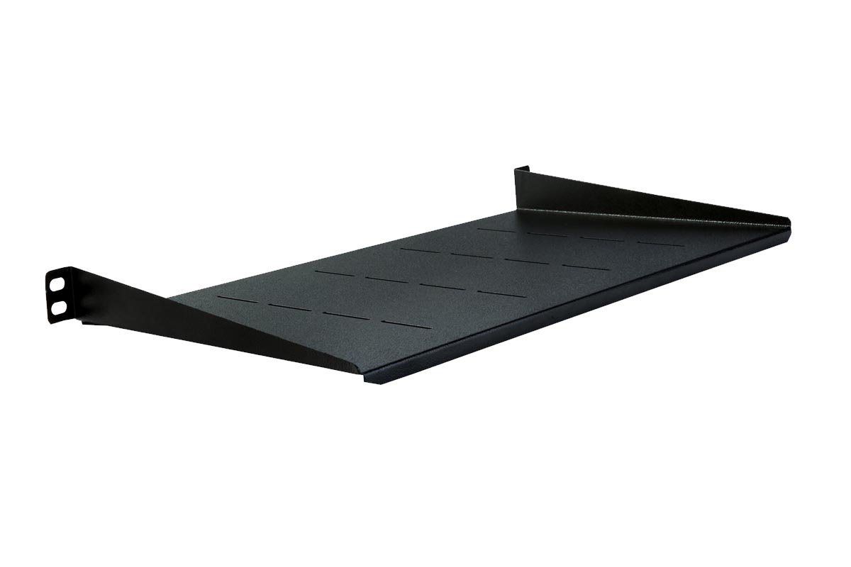
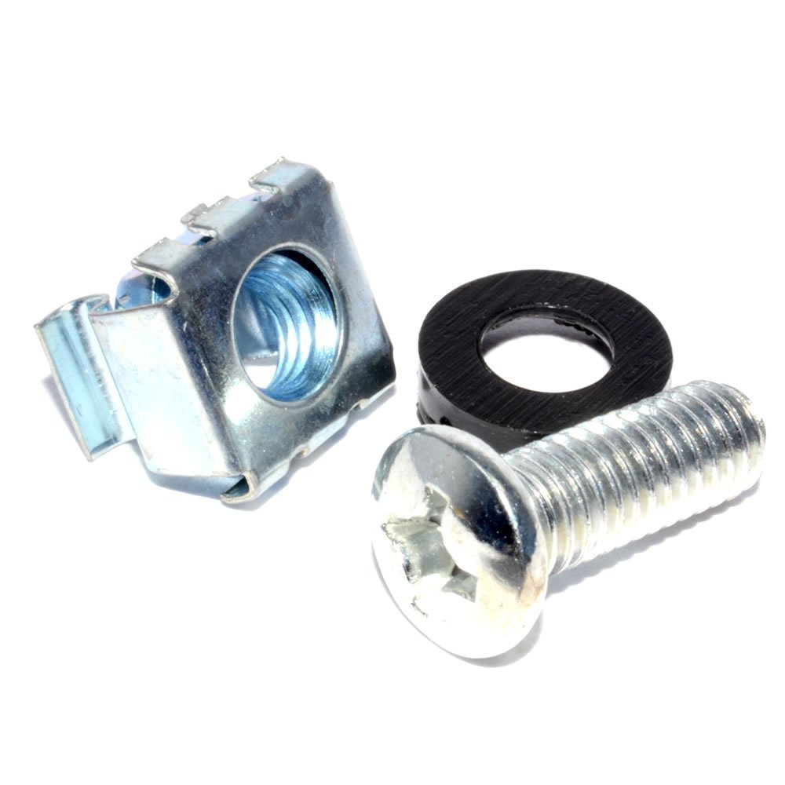
M6 Cage Nuts, Washers & Mounting screws for Server Rack & Cabinet
Mass Rack 10" Tray
It is used to mount network devices to racks.
16 needed per floor (inc. club house). 24 needed per block, central room & a few spares.
Quantity: 16 x 14 floors x 4 blocks + 16 x 15 floors + 16 x 2 club + 24 x 5 blocks + 24 central + 38 spares = 1350
Cost: ₹20 x 1350 = ₹27,000
Used to store additional length of cables below patch panel.
1 needed per floor (inc. club house). 2 needed per block, central room & a few spares.
Quantity: 1 x 14 floors x 4 blocks + 1 x 15 floors + 1 x 2 club + 2 x 5 blocks + 2 central + 5 spares = 90
Cost: ₹400 x 90 = ₹36,000

Slide 22
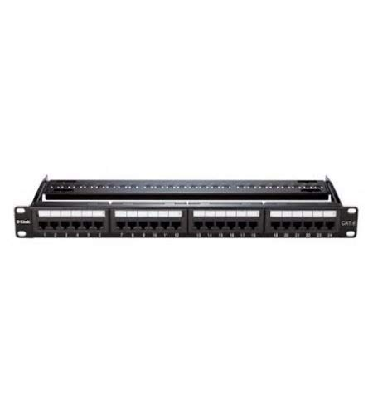
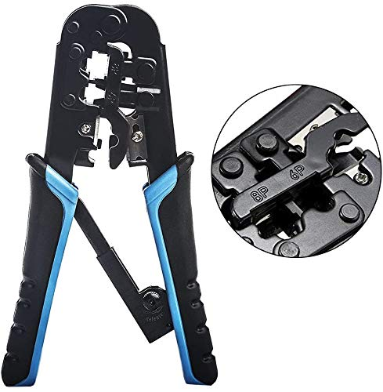
D-Link 24-port Cat6 Patch Panel
RJ45/11 Crimper, Cutter & Stripper Tool
It has ready to use RJ45 sockets on a panel that can be directly attacked to a network rack. This helps in cable management, and allows one to easily visualize, setup and debug network connections to switches / routers.
1 needed per floor (inc. club house). 2 needed per block, central room & a few spares.
Quantity: 1 x 14 floors x 4 blocks + 1 x 15 floors + 1 x 2 club + 2 x 5 blocks + 2 central + 5 spares = 90
Cost: ₹3000 x 90 = ₹2,70,000
This is a multitool that enables ethernet cables to be cut, insulation stripped, and the crimped onto a, RJ45 connector.
Would be useful when performing network setup to the flats, per floor cabinets as well as in network rack for server room. Preferable to have one spare per block.
Quantity: 5 blocks x 1 = 5
Cost: ₹600 x 5 = ₹3,000

Slide 23
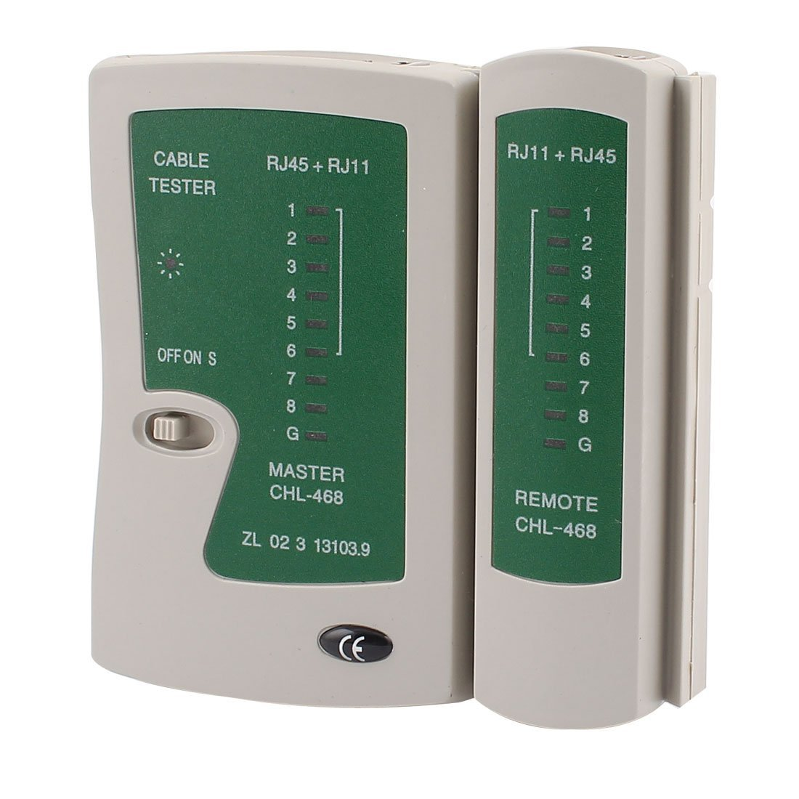
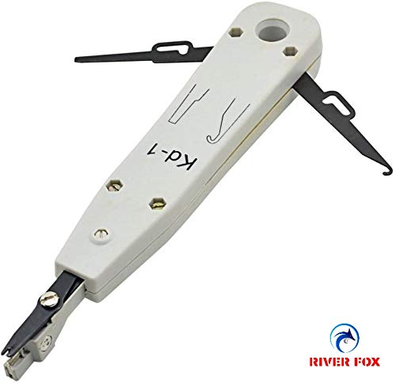
River Fox Punch Down Tool Cat 5e/6
Moelissa MS-LT02 RJ45/11 Cable tester
It helps connect LAN cable to RJ45 socket (Keystone) in a Wall socket or a Patch panel. After stripping the outer cover of the Cat6 cable & plastic pair-separator, and plugging it into a Keystone, a neat connection can be made with this tool.
Would be useful when performing network setup to the flats, per floor cabinets as well as in network rack for server room. Preferable to have one spare per block.
Quantity: 5 blocks x 1 = 5
Cost: ₹300 x 5 = ₹1,500
It helps check if a cable if properly connected to a network device (like switch). The remote helps identify wire you have connected to, if there are too many tangled wires.
Would be useful for debugging connectivity issues when performing network setup / management. Perfereble to have one spare per block.
Quantity: 5 blocks x 1 = 5
Cost: ₹300 x 5 = ₹1,500

